Slide 1

Machine Learning: Identifying Deck lists
Daniel Hing
Notes:
Hi, this is my project to build a machine learning model that can understand the Pokemon Trading Card Game, by identifying deck lists.

Slide 2


INTRODUCTION
Pokemon Trading Card Game
60 cards per player
Cardpool in the tens of thousands
No more than 4 of any unique card
(Excepting basic energy cards)
Archetypes
Overarching strategy
Uses similar cards
Unlikely to be the exact same
Notes:
An introduction. The Pokemon TCG is a card game composed of 60 unique cards per player. These 60 cards can consist of between 1-4 copies of each card, from a card pool numbering in the tens of thousands. These 60 cards generally form gameplans or archetypes around a particular strategy. Within those archetypes players will change the number of a particular card they use, change the utility cards used and sometimes add entire lines of new cards while staying within the archetype. Between all these factors for any given archetype, while there will be similarities, it is unlikely that a deck list used will be the exact same list of 60 cards.

Slide 3
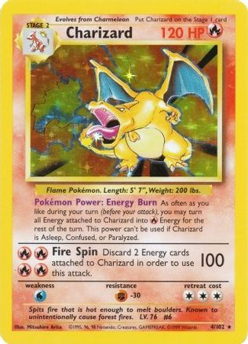
Goals
To use machine learning technology to build a model that can analyze a list of 60 current rotation Pokémon cards and output what archetype the deck list falls under, as well as use machine learning to analyse current trends and metas
Notes:
So introducing the goals that I had for this project. To use machine learning technology to build a model that can analyze a list of 60 current rotation Pokémon cards and output what archetype the deck list falls under, as well as use machine learning to analyse current trends and metas

Slide 4

Data Acquisition
Notes:
So my first section of the presentation is a dive into the method of how I captured the data required for my project.

Slide 5
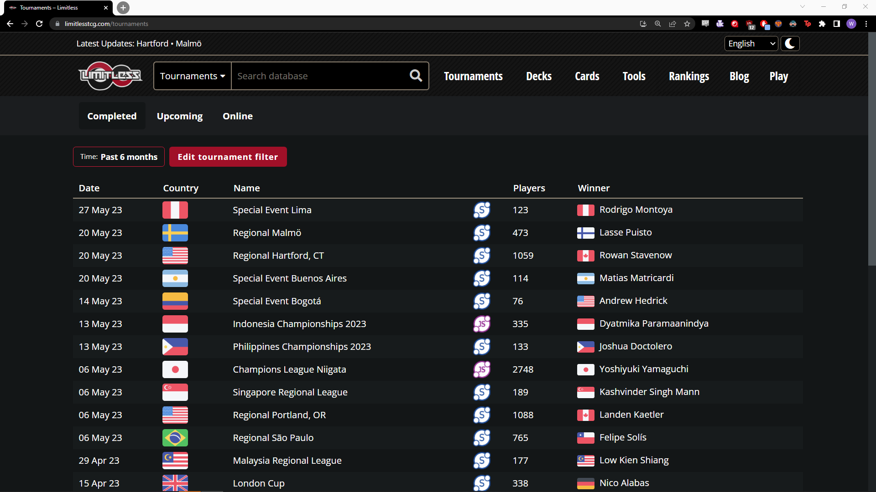
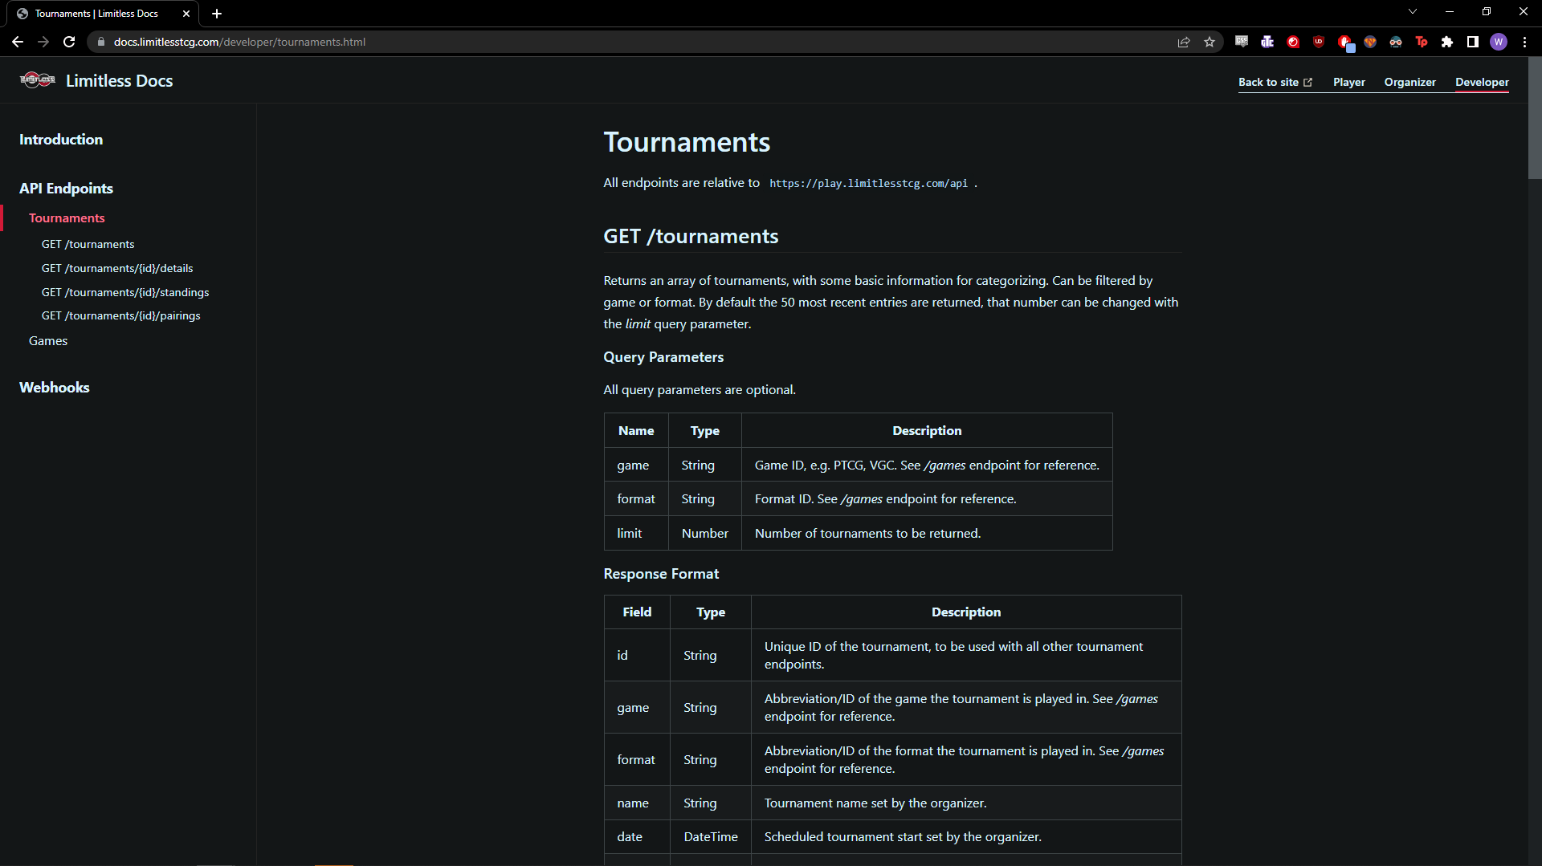

Building a database: Limitlesstcg
Used to get name/score/country data
https://docs.limitlesstcg.com/developer/tournaments.html
https://play.limitlesstcg.com/api/tournaments/tournamentid/?game=PTCG&format=standard&apikey
Notes:
Building a database: Limitlesstcg is a website that collates all existing submitted tournament data and displays the player data publicly. This includes player name, country of origin, placing and the full 60 cards used in each decklist.
They also provide an api, which users can request a key to.

Slide 6
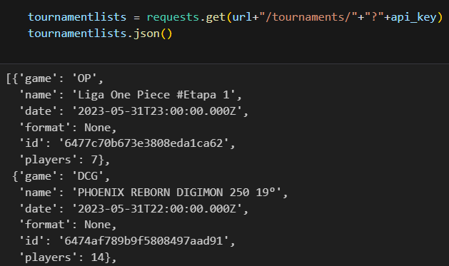
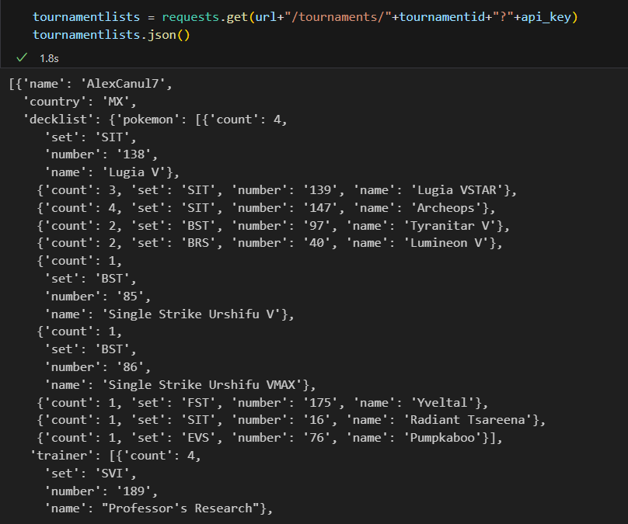

Building a database: Understanding the API
Tournament Request
https://play.limitlesstcg.com/api/tournaments/?game=PTCG&format=standard&apikey
Specific Tournament Standings
https://play.limitlesstcg.com/api/tournaments/tournamentid/standings?game=PTCG&format=standard&apikey
Notes:
Understanding the API
What does that API look like?
Utilizing python, I built an API request that filtered for tournaments.
This returns a limited to 50 list of tournaments of all games held on the platform (including other TCGs such as One Piece, Digimon and Magic)
Importantly it formatted results such that each tournament had a given “id”
I then filtered the query for the Pokemon Trading Card Game and “standard” format. By plugging in one of the returned pokemon tournament IDs I received that specific tournament standings.
The returned data included the deck list as shown as well as the deck archetype as given by the player under “deck id”
These 2 features will form the basis of our training data.

Slide 7
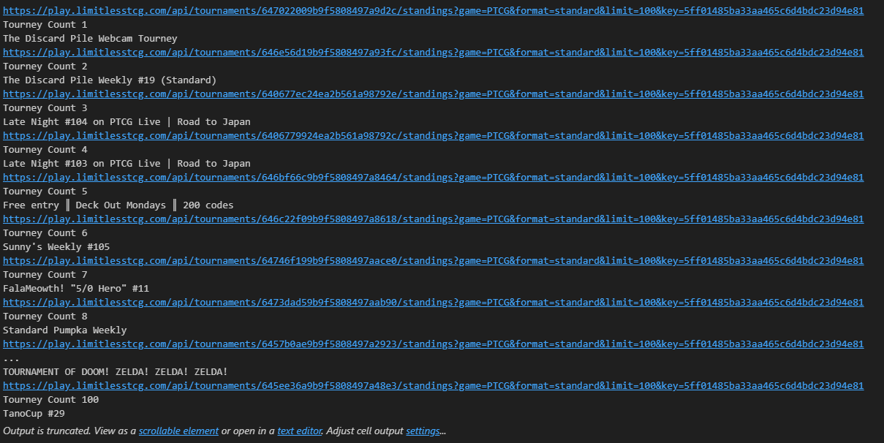
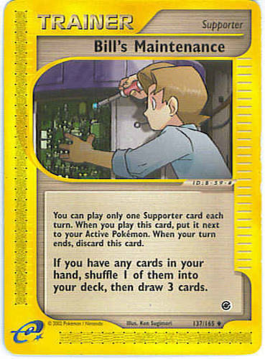
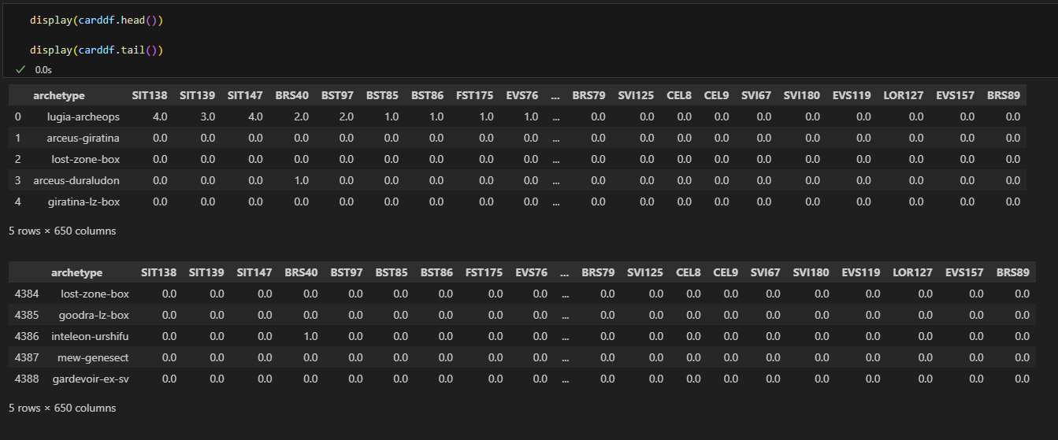
Building a database: Recording Values
Time ~ 3 minutes for 100 tournaments
4388 Decklists
Notes:
I iterated through the first 100 tournaments filtered for the pokemon tcg and standard.
As I iterated through the tournaments I add card counts to each unique card (by combining the “set” and “number” key value pairs), if a new card is encountered it is added as a column to the data frame before adding the card count. This means we do not have to add the 10s of thousands of cards in the game, and instead only add cards when they are relevant to the model.
This process takes about 3 minutes to run the code block, which resulted in 4388 decklists to use as our training data. While it is possible to grab more tournaments worth of data I felt that for my purposes this represented enough data vs time taken for my model.

Slide 8
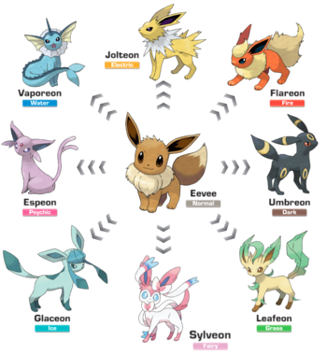
building a model
Notes:
So lets evolve our data into something new!

Slide 9
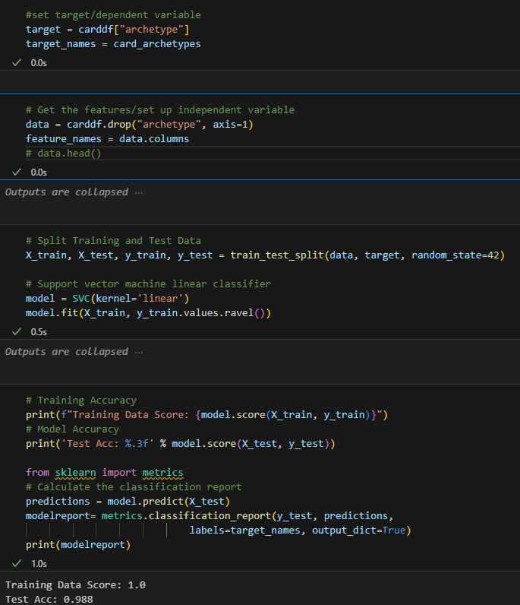
Building a Model
Dependent Variable – Archetypes Column
Independent Variable – Card Columns
Sklearn
train_test_split
75:25
Training Accuracy
1.0
Testing Accuracy
0.988
Notes:
I set my dependent variable to the deck archetypes column from within my data frame and then set my independent variable to the card columns/counts by dropping the dependent variable from my table
Using scikitlearn I created a train_test_split, to separate my data into a training and testing pool, on the standard split of 75:25.
Our Training accuracy was 1.0 and our testing accuracy was 0.988

Slide 10
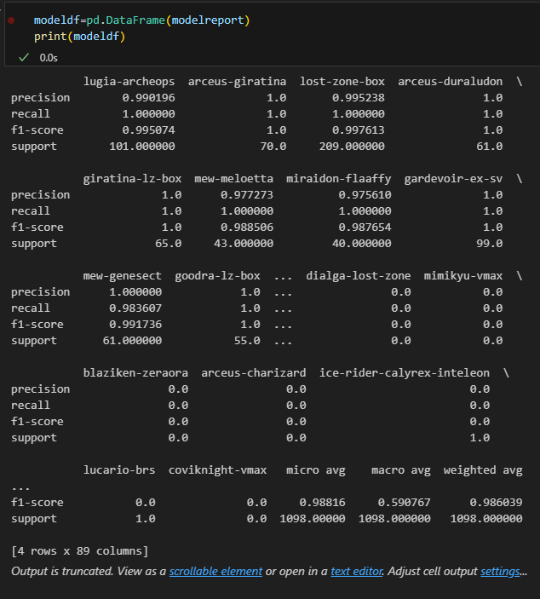
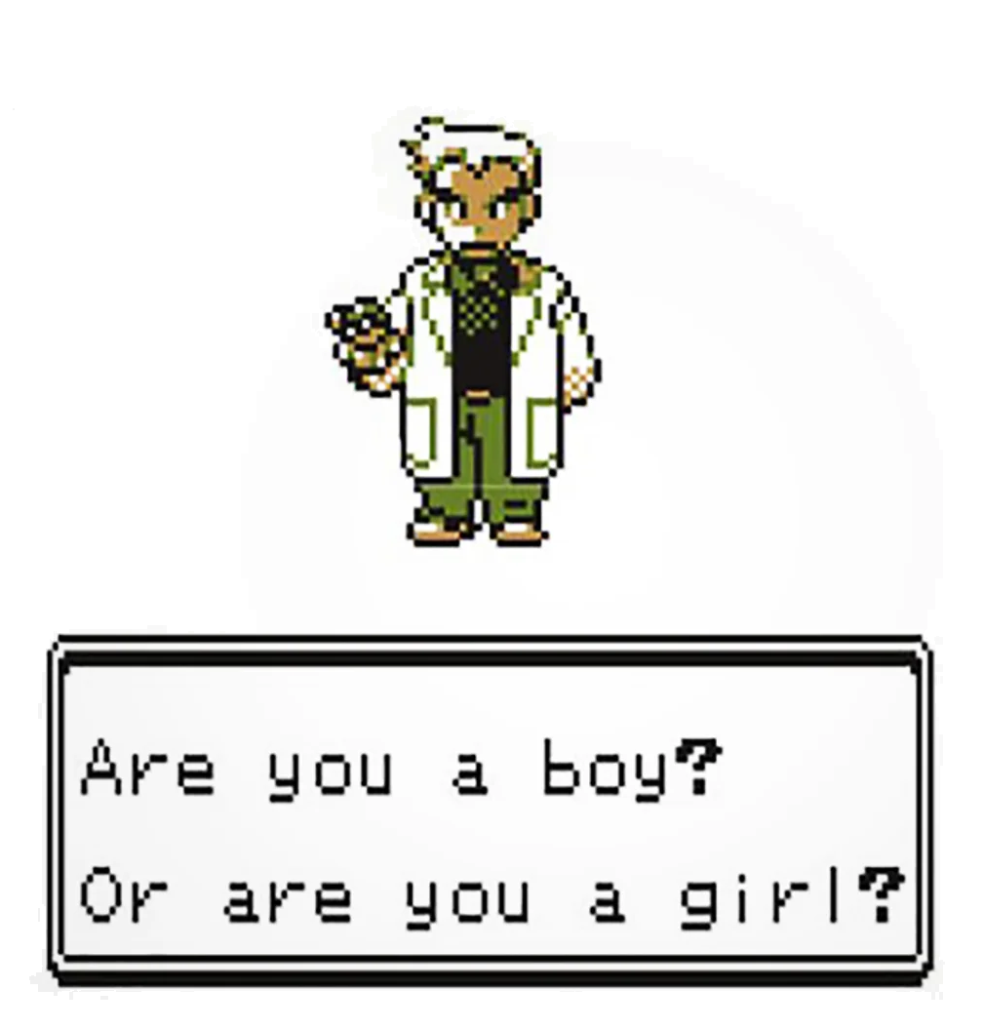
Classification report
Number of Decks/Support - 1098
High accuracy score – 0.988
High levels of precision – 0.986
High levels of recall – 0.988
Instances of 0.0
Support 0
Exists in training split
Not in testing split
Notes:
Using SciKitLearn I created a classification report
For the purposes of future data visualisations I formatted the classification report as a dictionary, so it could be input into a dataframe.
My testing split consisted of 1098 individual decklists and an accuracy score of 0.988
As expected due to our high accuracy score, our model shows high levels of precision (positive predictive value) and recall (sensitivity)
There were instances of 0.0 for precision and recall. The support showing 0 indicates that within our testing data set there were no instances of the deck despite existing in the training set. This is not unexpected as some archetypes are not common archetypes and more just deck lists that people experiment with.

Slide 11
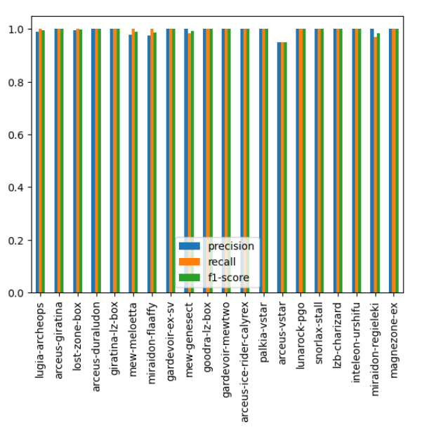

Plotting the classification report
Precision
Recall
F1 Score
Output for Player Score in 2020
Notes:
As mentioned earlier we can plot the classification report data frame. Using the dependent on our x axis we can visualize the accuracy of our model by plotting the precision, recall and f1 score of our model. As you can see there’s very high precision and recall within our model.

Slide 12
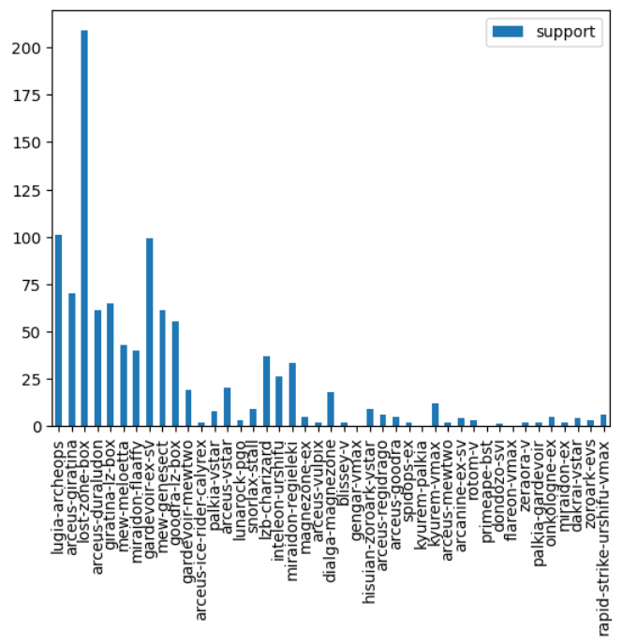

meta output
Use case
Support – represents number of times the archetype appeared in the data
Notes:
We can also plot the support as it’s own graph. This fulfils one of the goals of my project. By visualizing support of archetypes within the last 100 tournaments we get an overarching view of the shape of the meta. Users can quickly identify what the most popular decks are for the dataset.

Slide 13
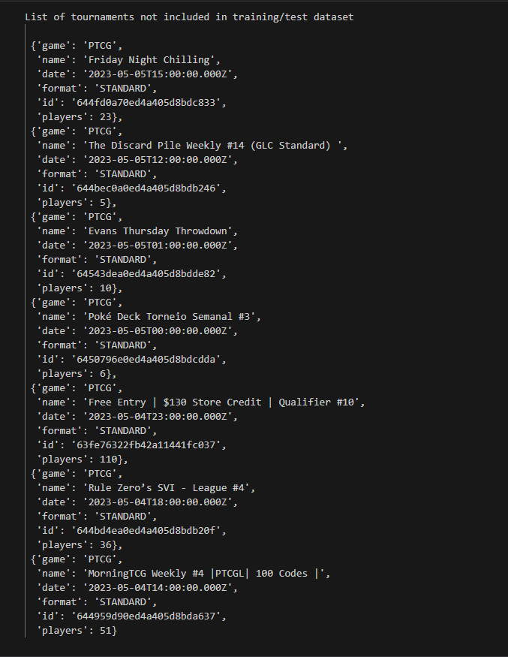
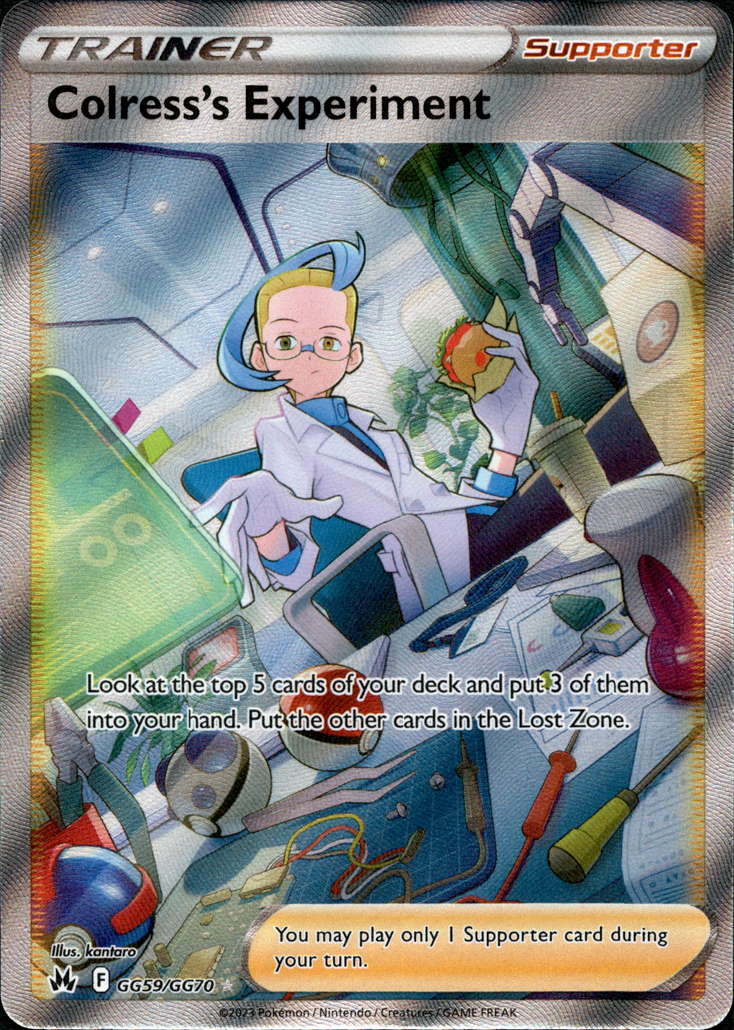
Trialing the use case
Create list of tournaments untouched by model
Pick a tournament and store in dataframe
url+"/tournaments/"+644959d90ed4a405d8bda637+"/standings?"+api_key)
Format the data for usage by the model
Input into the model
Notes:
The goal of the project was to create a model that could take lists it hadn’t seen and be able to correctly predict what archetype those input lists were. While this was done with the train_test_split I wanted to try using the model as my use case would. To do this I generated a list of tournaments as yet untouched by the model. I then stored the data from a tournament from this list, and input it into the model

Slide 14
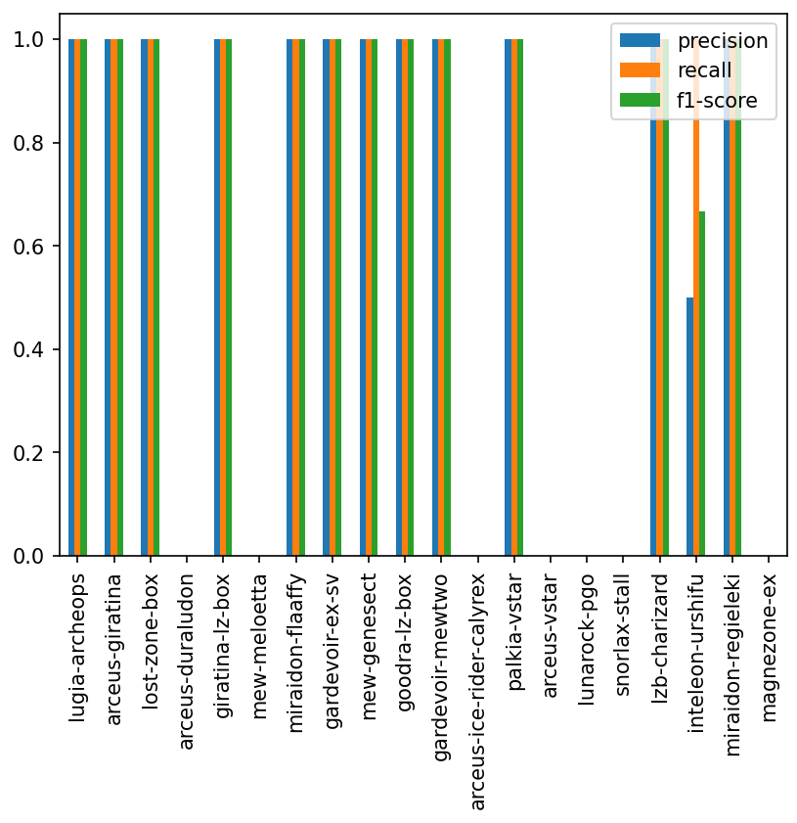
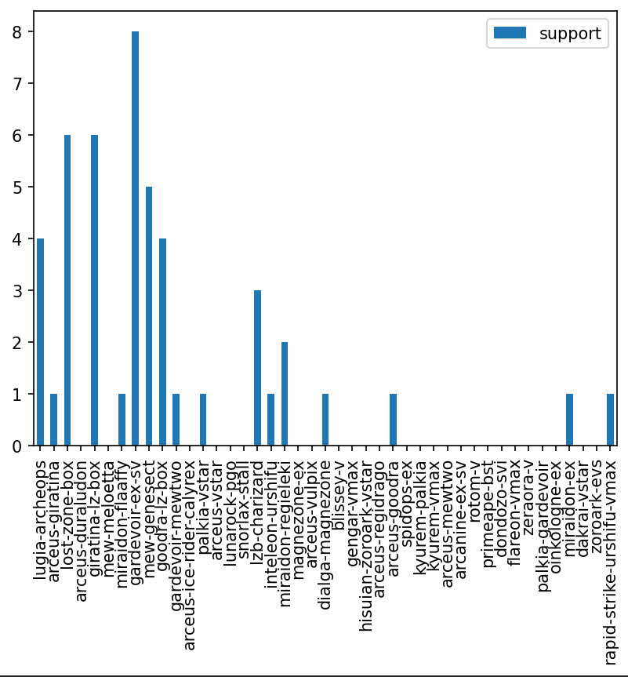
Displaying the trial Output
Number of decks/Support - 49
Test Accuracy – 0.98
48/49 decks correctly predicted
Several missing archetypes in the trial data vs training data
Notes:
My trial output came out successfully. The number of usable decks in this trial data set was 49. We had strong precision and recall from our model. With a test accuracy of 0.98 my model correctly predicted the archetype of 48/49 decks.
As you can see not all archetypes that appeared in the training data appeared in the trial data.
This shows that my model is capable of handling data outside of it’s original parameters and has achieved the project target goal of being able to analyze deck lists and predict it’s archetype

Slide 15
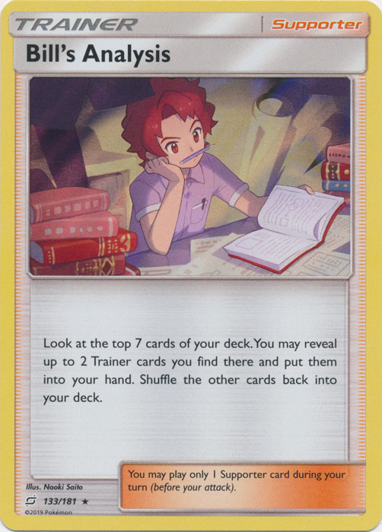
Conclusions and analysis
Conclusions
API
Machine Learning
Visualisations
Changes
Model
Matchup winrates
Localised metas (geographical)
Popularity
Other TCGs
Classification Models in other applications
Notes:
A discussion of the key features of my project, their implementation and strengths, and how this project could be adapted in future
APIs create a powerful tool to communicate between clients and servers. Through navigation and use of the limitless API I was able to pull everything I needed to train my machine learning model
Machine Learning represents an exciting utility that can process data at a rate that is incomparable to what a human can. By creating a model that is purpose built towards a specific goal data analysts can gain deeper understanding of a data set
Visualisations aid analysts in their ability to identify patterns and changes in data. The presence or lack thereof of data within a visualization is directly linked to real-world causes
Given more project time the scope of the project can increase or be adapted to introduce new functionality.
For example within the limitless source data we are given standings, as well as performance and matchups. We can use this to have a model identify matchup win rates between specific archetypes. Alternatively we can take a wider view and figure out which decks perform best generally or filter for specific countries or regions and find what localised data sets exist within. We’re also not limited to only pokemon. The model very easily can be adapted for other TCGs such as Magic the gathering, Digimon or one piece to achieve similar outcomes for other games.
Taking an even more macro view I believe my project has demonstrated that given a robust data source, a classification model can be used to achieve various outcomes, being able to identify or class a data source via machine learning is useful in a wide variety of spaces.

Slide 16

Bibliography
Limitless TCG website <https://limitlesstcg.com/>
Notes:
A big thankyou to limitless tcg for providing the API for my machine learning model

Slide 17

THANK YOU
Notes:
Thank you for (mandatorily) attending my presentation! It was a lot of fun to make both while researching the topic and putting together the code. Watching the model slowly come to life had me as excited as this kid pulling his first blastoise pokemon card.

